Slide 1

Team Details
Team name: A²
Team leader name: Buddha Gosh Sakyang Rahula
Problem Statement: Open Innovation

Slide 2

Brief about your solution and problem statement addressing
The Issue: Long queues during peak college hours and tedious
manual payment verification at canteen counters.
Current Friction: Reliance on physical tokens or manual record-keeping
leads to slow service and potential revenue leaks.
The Goal: Streamline the "browsing to serving" flow using a hybrid model
of food delivery and event ticketing logic.

Slide 3
Opportunities
How different is it from any of the other existing ideas?
How will it be able to solve the problem?
Unlike standard delivery apps that focus only on remote ordering, this system is a hybrid solution specifically built for the high-traffic, closed-loop environment of a college campus. It combines the real-time menu browsing of a food delivery platform with the secure, color-coded ticketing logic of event management software. This allows for instant digital verification at the counter while still accommodating offline cash payments through a specialized "Pay at Counter" workflow.
The system eliminates the two biggest bottlenecks in college dining: queues and verification friction. By allowing students to order and generate "Digital Passes" remotely, it prevents crowding at the menu board. For the canteen staff, the QR scanner module replaces manual ledger-keeping with a one-tap verification process that instantly confirms payment and prevents fraudulent double-scanning of tokens.

Slide 4
Key Features
Live menu and availability: Real-time visibility of items (Lunch, Snacks, Drinks) with "Sold Out" status indicators.
Flexible Payments: Support for online UPI/Cards and a "Pay at Counter" offline mode.
Color-Coded QR Tokens: Instant digital passes; Green for paid, Orange for payment pending.
List of features offered by the solution

Slide 5
Google Technologies used in the solution
Firebase Realtime Database: Used for instant synchronization of menu availability and order statuses between students and canteen staff.
Firebase Cloud Messaging (FCM): Enables real-time push notifications to alert students when their food is "Ready for Pickup".
Google Pay (GPay) API (via RazorPay): Facilitates secure, one-tap UPI transactions directly within the student application.
ML Kit (Barcode Scanning): Powers the high-speed QR code scanning module in the staff app for instant token verification.
Google Sheets API: (Optional) Can be used as a lightweight administrative backend for the canteen manager to update prices and view daily sales reports.

Slide 6
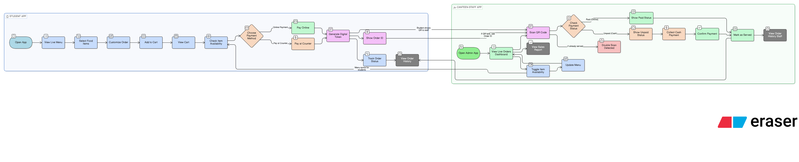



Process flow diagram or Use-case diagram

Slide 7
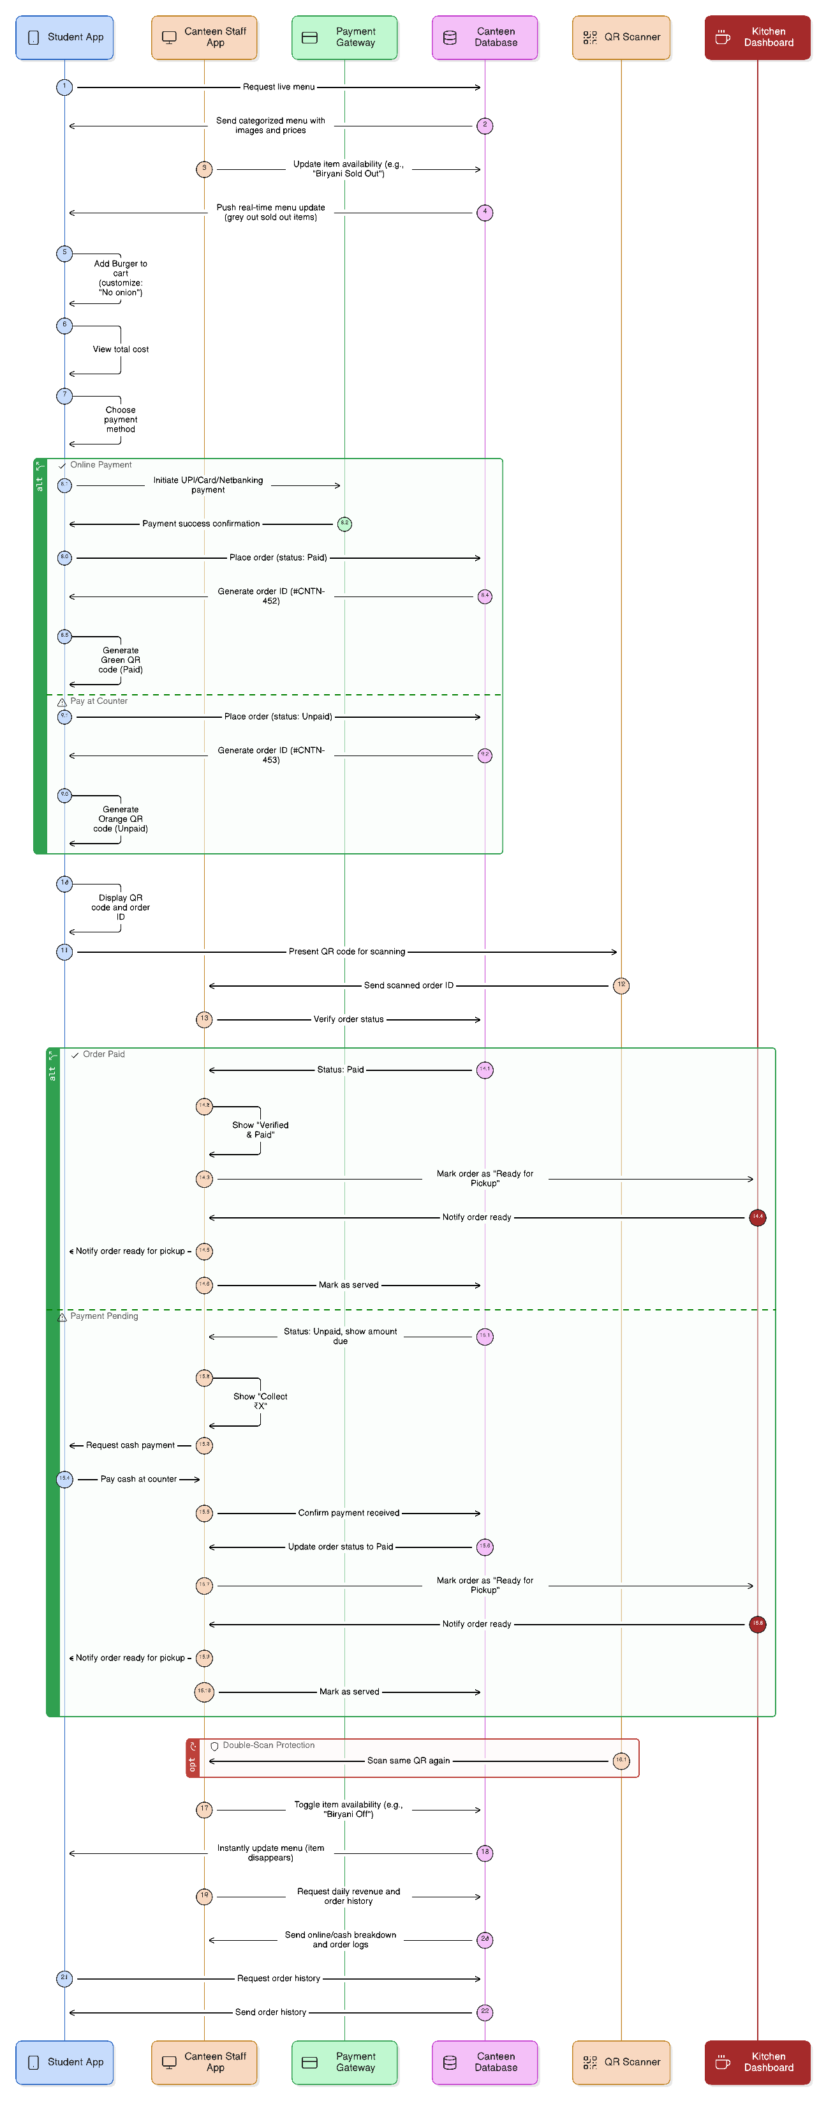
Wireframes/Mock diagrams of the proposed solution (optional)

Slide 8
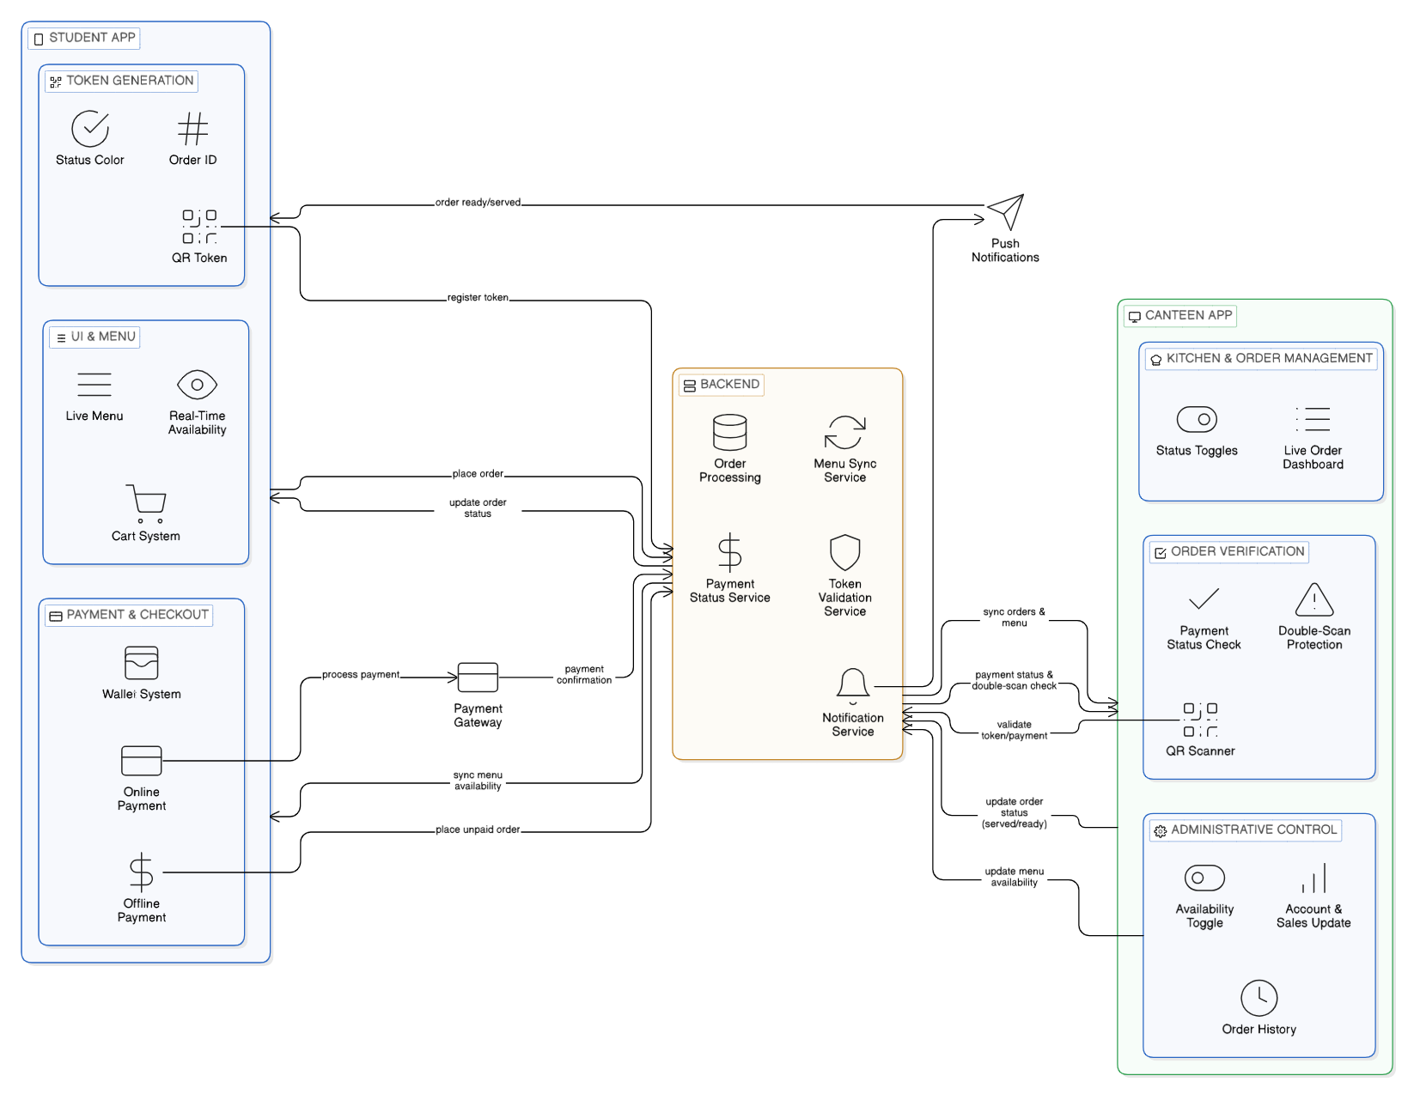
Architecture diagram of the proposed solution

Slide 9
Snapshots of the MVP

Slide 10
Additional Details/Future Development (if any)
Short-Term Enhancements (Optional Features)
Integrated Wallet System: A dedicated student wallet within the app to allow for faster checkouts and pre-loaded credits, reducing dependency on external payment gateways during peak hours.
Backup Order Verification: Implementation of text-based "Order IDs" (e.g., #CNTN-452) as a secondary verification method for the canteen staff if a student's phone screen is damaged or the QR scanner fails.
Order Ready Notifications: Automatic push notifications (via Firebase) to the student's phone the moment the kitchen staff marks an order as "Ready for Pickup".
Long-Term Future Developments
AI-Powered Demand Forecasting: Using historical sales data to predict high-demand days (e.g., Biryani specials), helping the canteen staff optimize ingredient purchasing and reduce food waste.
Pre-Ordering & Scheduling: Allowing students to schedule their meal pickups in advance (e.g., ordering at 10:00 AM for a 1:00 PM lunch) to better distribute the kitchen workload.
Loyalty & Reward Program: Automated reward points for frequent users or "Combo Deals" suggested by the system based on the student's previous ordering habits.
Nutritional Tracking: Integration with health APIs to show the calorie count and nutritional value of each meal, promoting healthier eating habits on campus.

Slide 11
Provide links to your:
GitHub Public Repository:ajinjojan/CampusEats
Demo Video Link (3 Minutes)
MVP Link

Slide 12
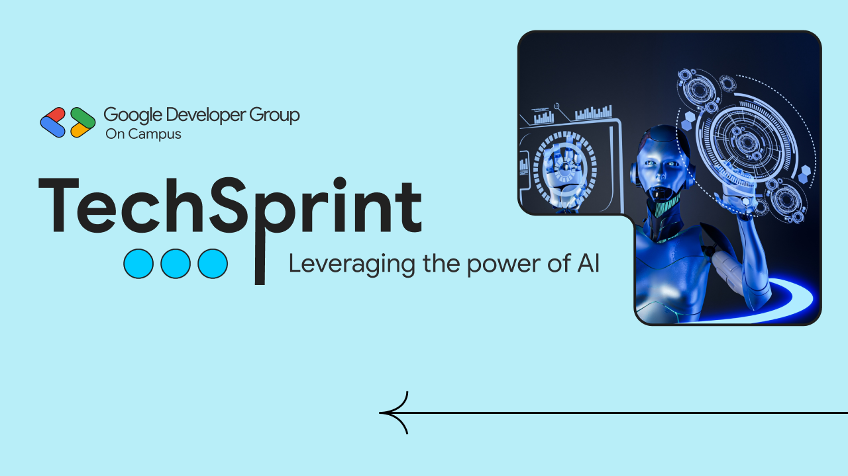
Thank you!

